Slide 1
Clinical Breakout Session – Immunization Module
Immunization Station
Jasmine Johnson

Slide 2
Breakout Session Agenda
What is the Immunization Module?
What ways can I chart immunizations?
Overview of Immunization Module.
Admin Quick Tips (Default Selection for Quick Documentation)
“Immunization not found”
Key Tips
Additional Enhancements
Enhancements coming soon!
Q&A

Slide 3
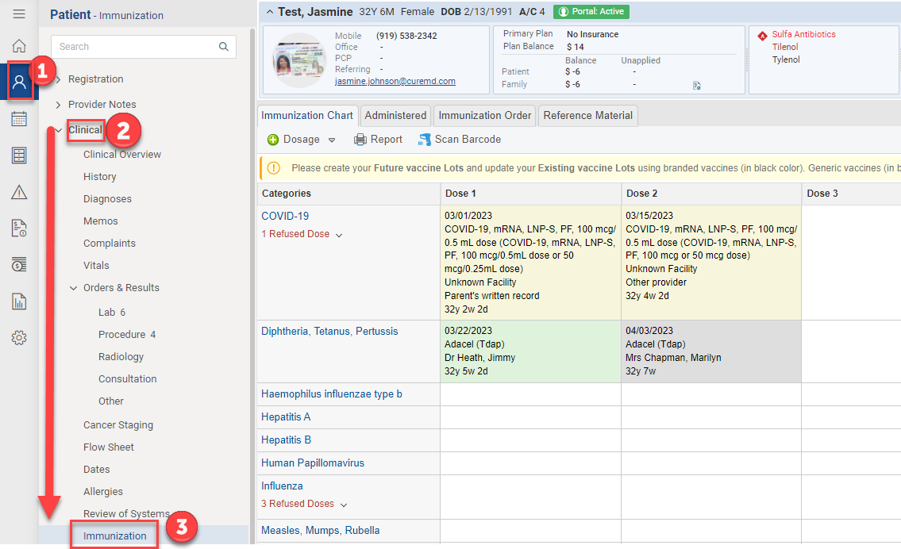
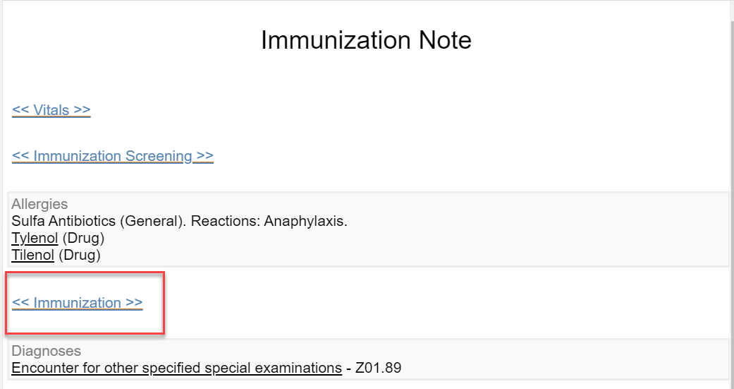
What is the Immunization Module?
Patient chart of administered, historic and refused vaccines.
View from:
a provider note (most common workflow)
Directly from patient account
Can be connected to your state’s immunization registry
(requirements and connection times vary per state)

Slide 4
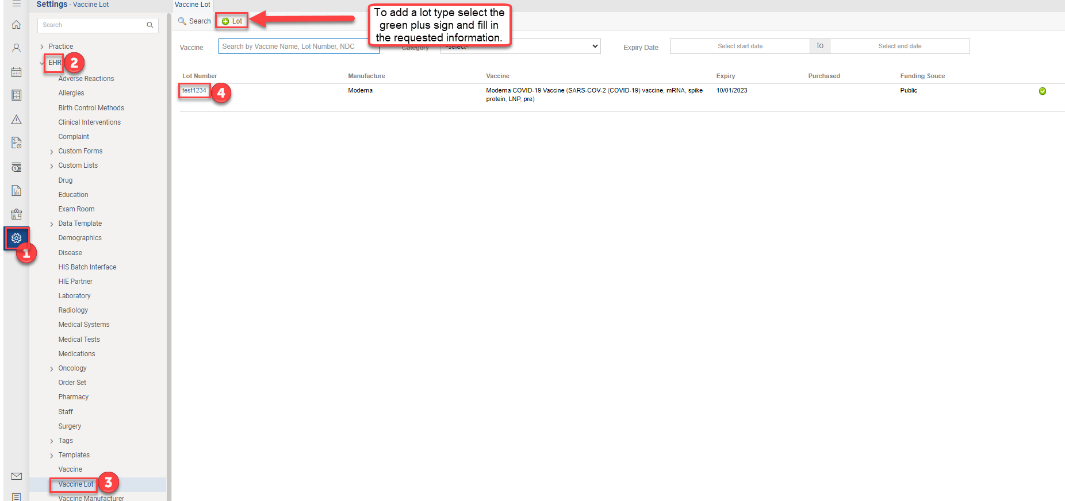
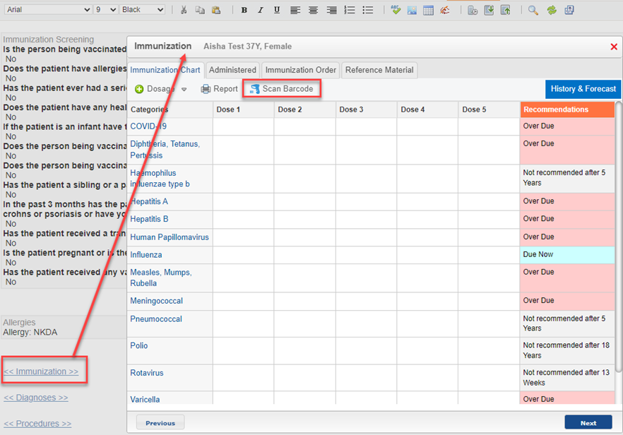
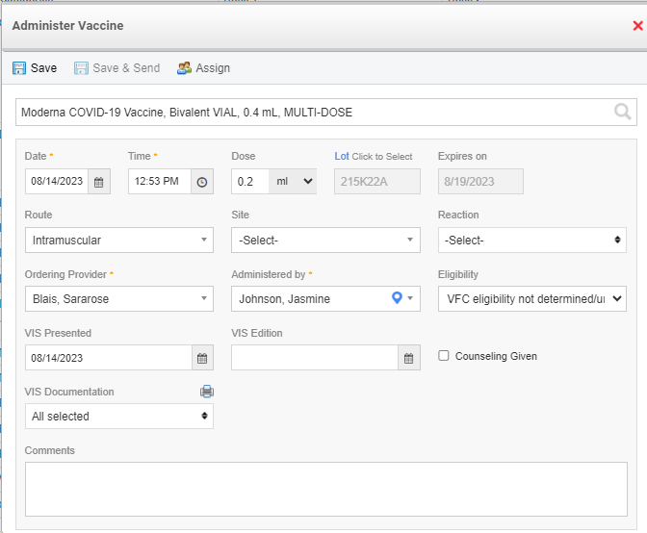
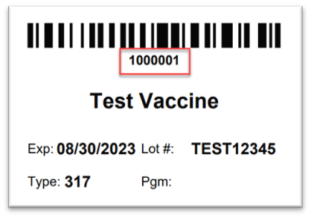
What ways can I chart immunizations?
Lot Types
Add
Administer
Scan Barcode

Slide 5
Overview of Immunization Module via Barcode Method

Slide 6
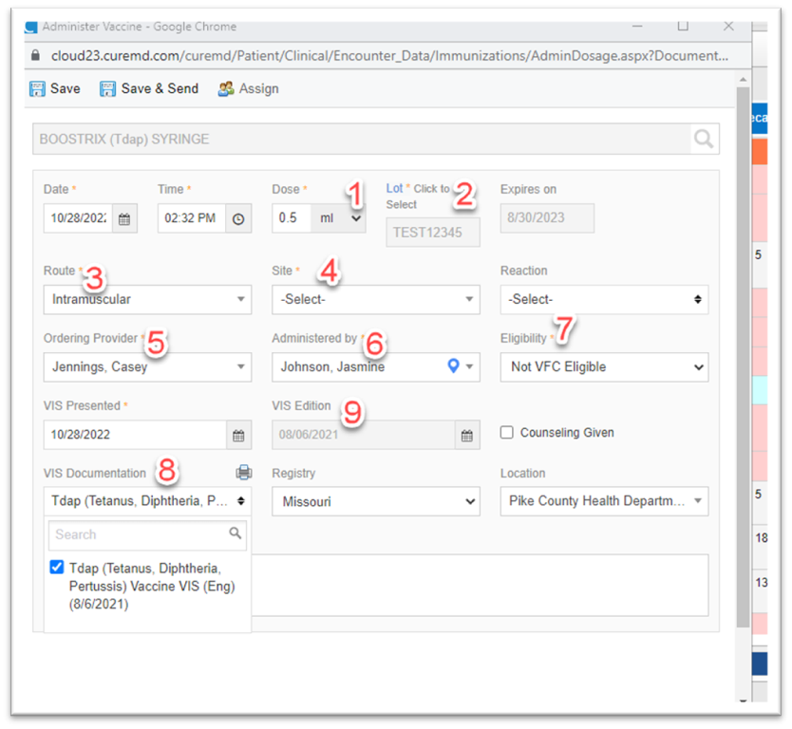
Admin Quick Tips
Vaccine administration defaults
Dose
Lot
Route
Site
Ordering Provider
Administered By
Eligibility
VIS Documentation
Date VIS Published and Reportable to Registry

Slide 7
“Immunization Not Found” – Barcode Method
Ensure inventory module has the product with the 11-digit NDC format (5-4-2).
Ensure charge code/CPT code is attached to product under billing tab in inventory module
Ensure inventory has been received and there is product available to dispense

Slide 8
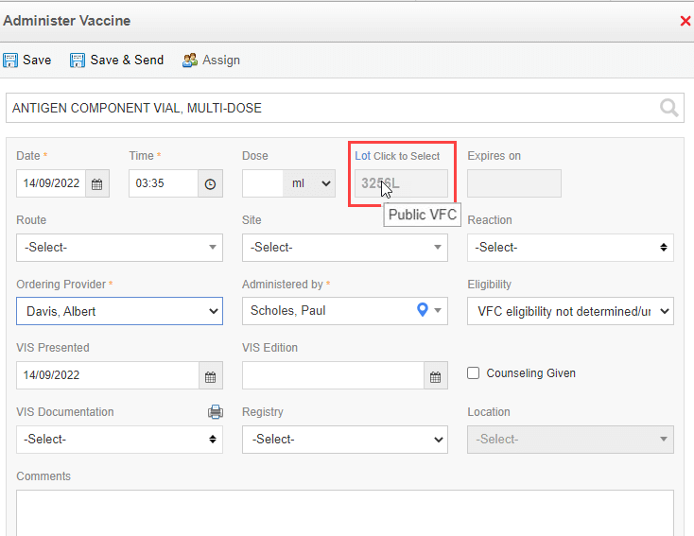
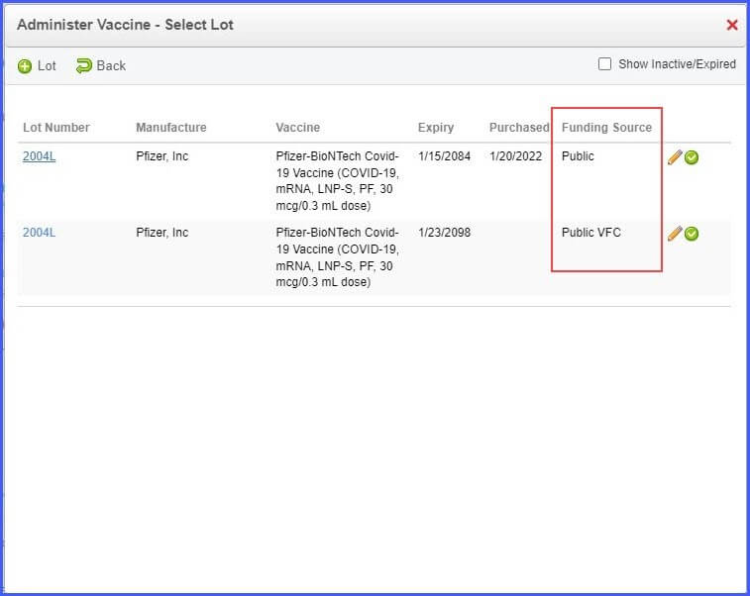
Key Tips
Funding source now displays as a column in vaccine lot.
Funding source is shown when hovered over the lot number, once the lot is selected.

Slide 9
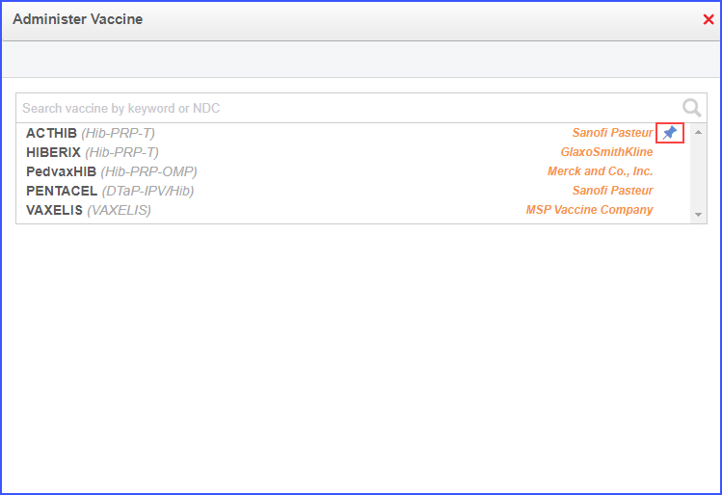
Key Tips for Lot Type Users
Lot type users can benefit from the ability to pin their most used/favorite vaccines
On the ‘Administer Vaccine’ screen, when the user hovers over a vaccine in the list, a pin icon appears next to the vaccine manufacture’s name.
Once pinned the vaccine turns blue
Users can also search for a specific lot, Sale and NDC numbers

Slide 10
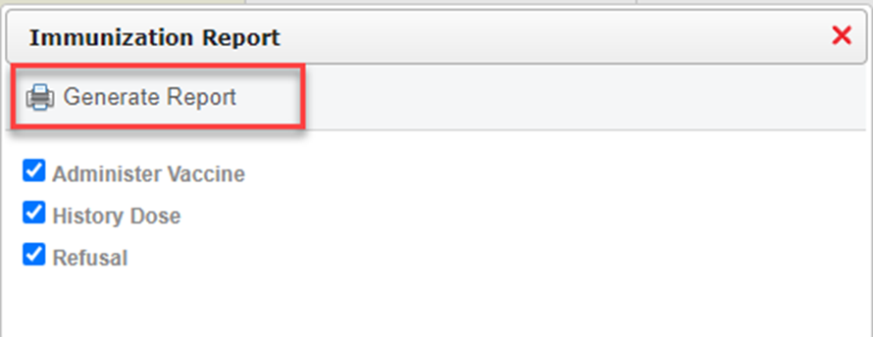
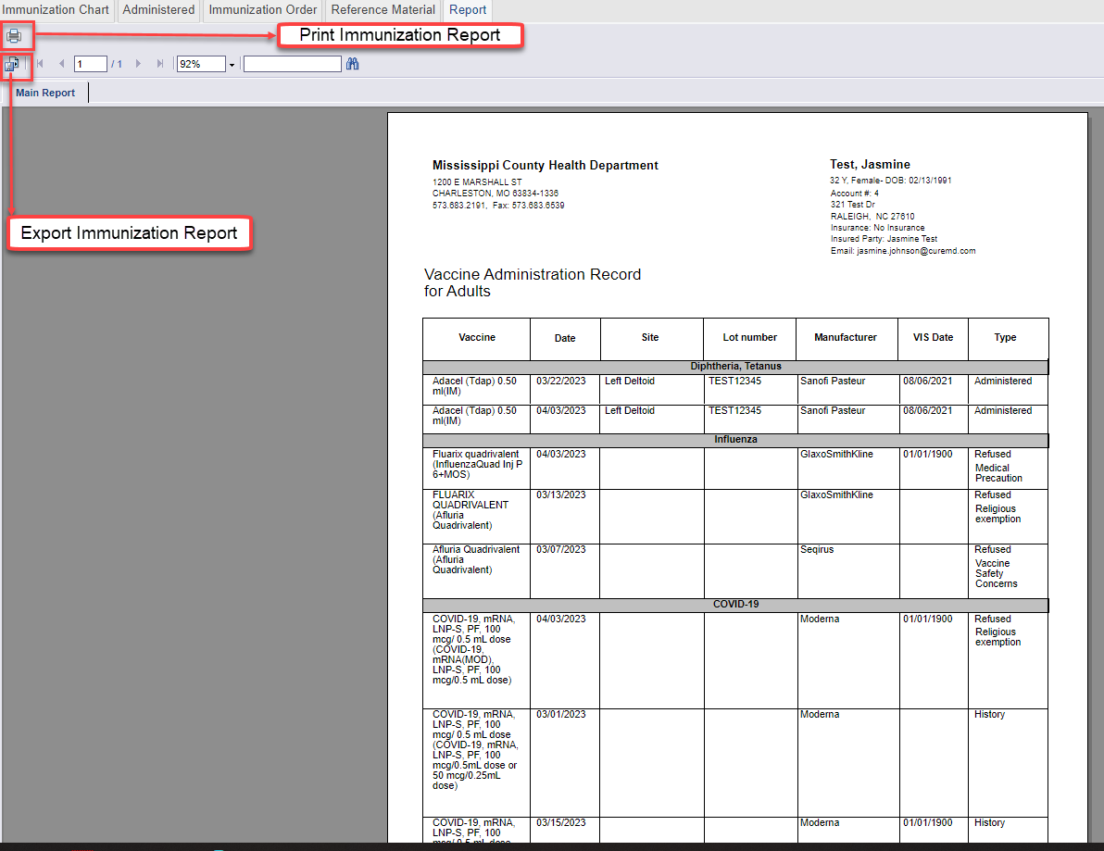
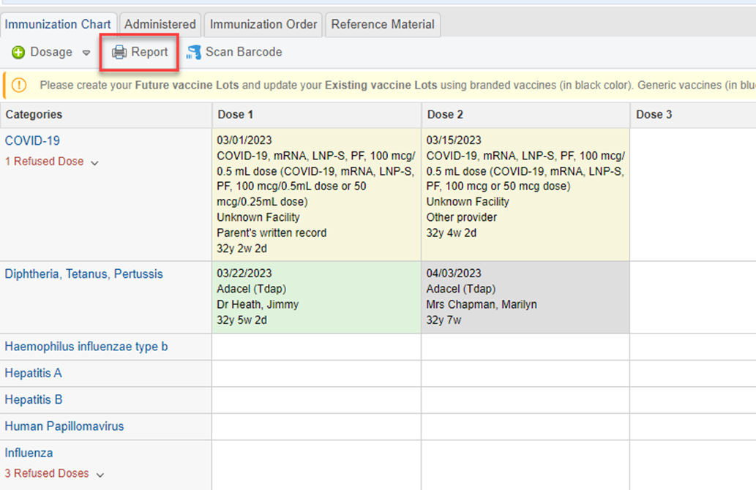
Key Tips
Immunization Report
Example: copy of immunizations received (administered, historical, refused)

Slide 11
Additional Enhancements
Route and Site have been defaulted to only what the registry accepts.
A new EHR permission to allow Admin users to pin vaccines for an entire practice

Slide 12
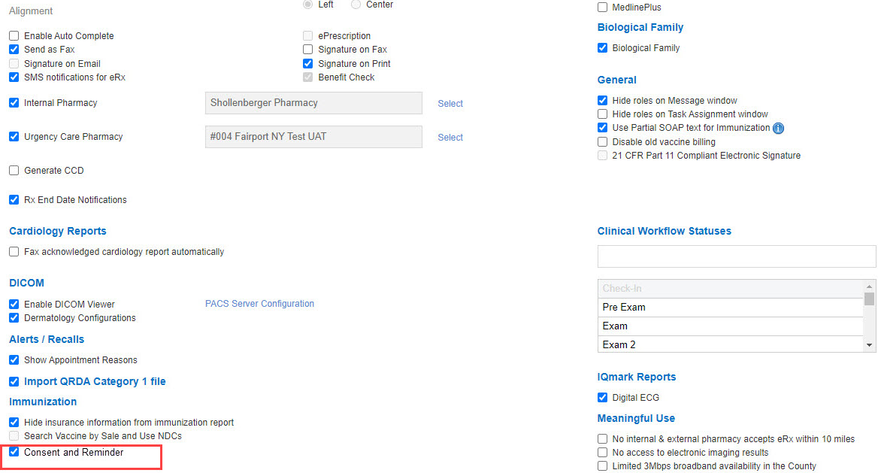
Enhancements Coming Soon!
Coming Soon:
In stock indicator when searching vaccines (available for lot type workflow)
Consent reminder on vaccination administration screen and on demographics page

Slide 13
Q&A

